Slide 1
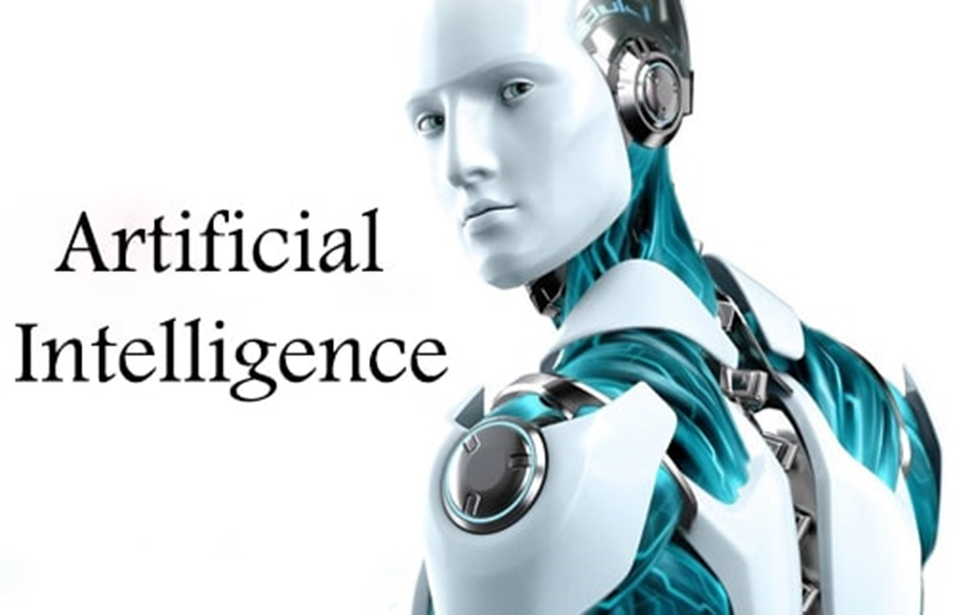
1 . 3 A R T I F I C I A L I N T E L L I G E N C E D E M O
s
S r i r a m - I T E x p e r t
Y o u t u b e C h a n n e l : I n t e l l e c t S r i r a m

Slide 2
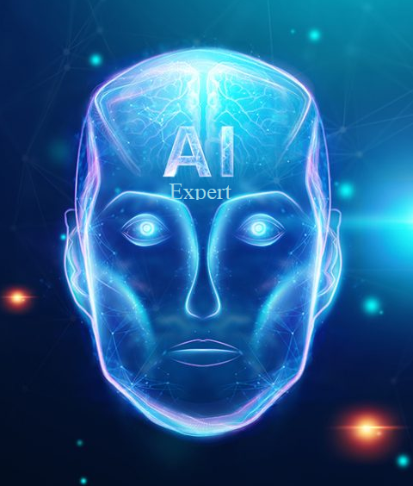
What is Artificial Intelligence?
Welcome Artificial Intelligence Expert
The theory and development of computer systems able to perform tasks normally requiring human intelligence, such as visual perception, speech recognition, decision-making and translation between languages.
Artificial Intelligence is a technique that enables computers to mimic the human behavior
Artificial Intelligence needs high computational power & can work 24/7 with same efficiency where as Human computational power is limited & Human have limited working capacity
Artificial Intelligence have two subsets namely Machine Learning with 95% of accuracy and Deep Learning 99% accuracy

Slide 3
Artificial Intelligence View
Welcome Artificial Intelligence Expert
On one side, Artificial Intelligence is viewed as all ‘Robots or Bots' and that everyone in the country is worried about their job being displaced by a machine. (There are projections by the World Economic Forum of 5 million jobs being lost. Clerical is being targeted as one of the primary sectors, and finance, law are others that are being targeted as well.) Bots are a type of AI system that are often used for telemarketing and sales interactions, taking the place of humans.
On another side, Artificial Intelligence is viewed as ‘Augmentation of the human'. So not just artificial intelligence alone, not just the human alone, but the marriage of the two, and having more the emergent properties being more than either of them.
“Artificial Intelligence system will work parallelly humans for efficient work and time consuming”

Slide 4
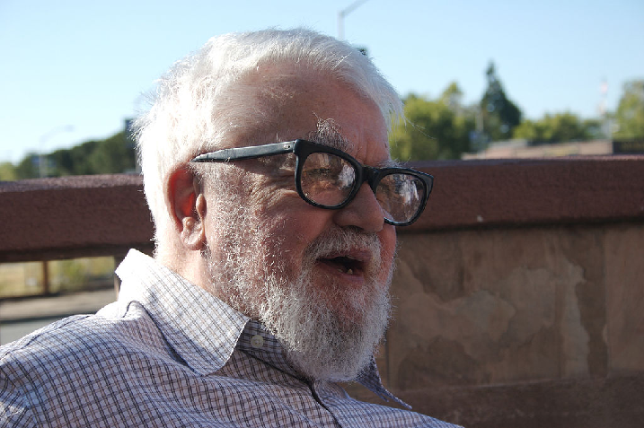
John McCarthy - Father of Artificial Intelligence
Welcome Artificial Intelligence Expert

Slide 5
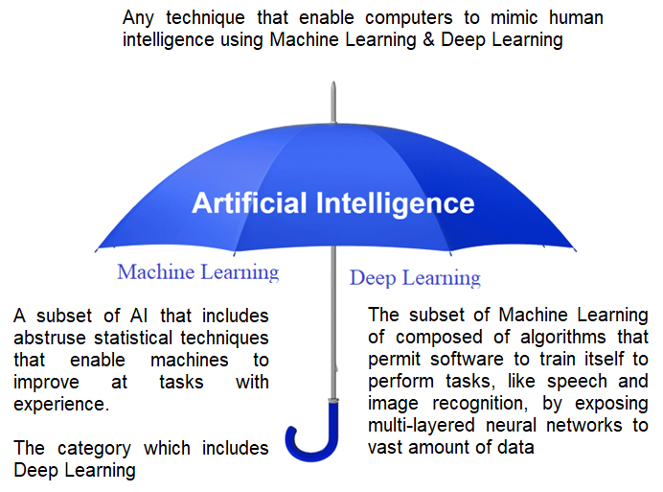
AI Umbrella
Welcome Artificial Intelligence Expert
Deep Learning uses neural networks to simulate human like decision making

Slide 6
Artificial Intelligence – State of the Practice
Welcome Artificial Intelligence Expert
Three big improvements in technology are:-
On demand computing
Huge volume of data
Better computing power
Many commercial applications work on the basis of supervised machine learning
Compare and predict images
Translate transcripts into multiple languages
Recognize and connect voice based on transcripts
Predict percentage of successful loan repayments

Slide 7
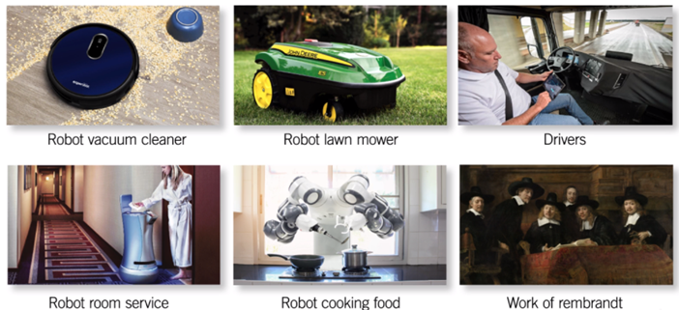
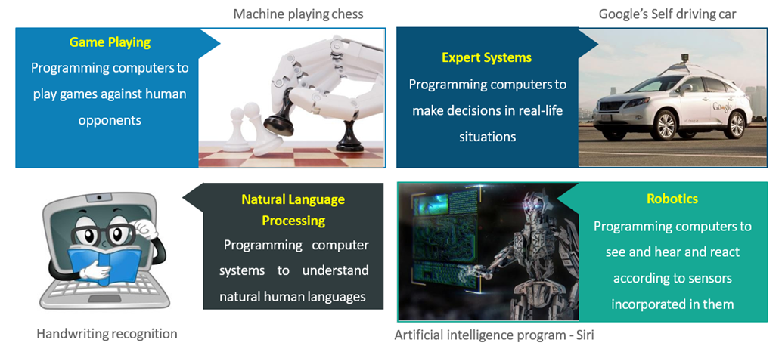
Examples for Artificial Intelligence
Welcome Artificial Intelligence Expert

Slide 8
Artificial Intelligence Vs Humans

Slide 9
Artificial Vs Human Intelligence
Welcome Artificial Intelligence Expert
Artificial Intelligence | Human Intelligence
Artificial Intelligence, When given the information can be exact, every time with the speed | When Human Intelligence, give the same information, it cannot be exact and is slower
Artificial Intelligence are digital | Human Intelligence are analogue
Artificial Intelligence uses byte addressable memory | Human Intelligence uses content addressable memory
There is appealing hardware/software distinction obscures in Artificial Intelligence | No hardware/software distinction can be made with respect to the brain or mind
Processing and memory are performed by the different components | Processing and memory are performed by the same components in the brain
Artificial Intelligence could do this if it was program to do so, but this would be counter productive | Human Intelligence can chance to forget and loose information

Slide 10
Human Vs Machine Evolution
Welcome Artificial Intelligence Expert
Machines can evolve and propagate knowledge at a much faster rate in comparison to humans
Human Evolution
If a human makes a mistake and learns how to correct it, that human has learned and corrected that mistake;
However, how long will it take before the world can learn what that one human has learned?
Machine Evolution
When a computer learns something, the propagation of this knowledge is instantaneous;
Not only that, every new machine that is born already has this knowledge.

Slide 11
Human Vs Machine
Welcome Artificial Intelligence Expert
Between humans and machines, either has unique advantages over the other, and these advantages can be used for them to work well together.
Human | Machine
Empathy | Memory
Lead | Prediction
Intuition | Processing
Inventing | Reprogram
Judge | Endurance

Slide 12
Disruption in Industries

Slide 13
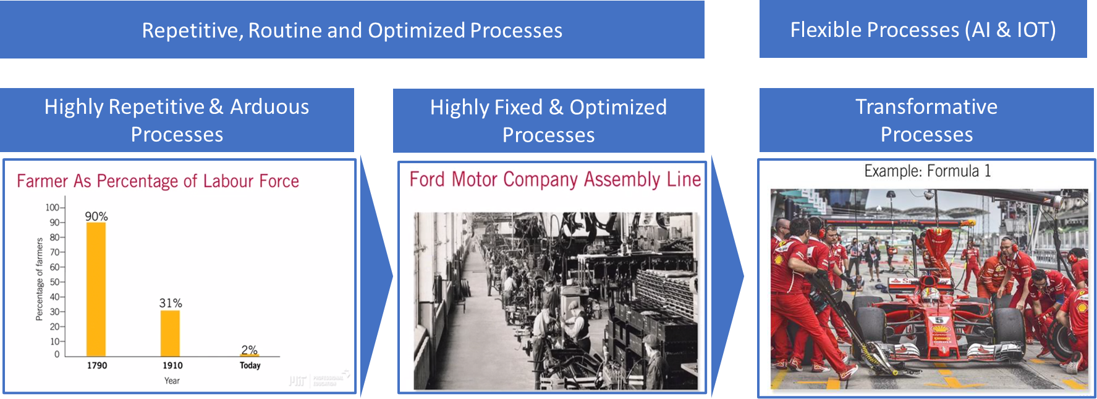
Disruptions in Industries
Welcome Artificial Intelligence Expert
Combining AI systems and human oversight offers complimentary advantages

Slide 14
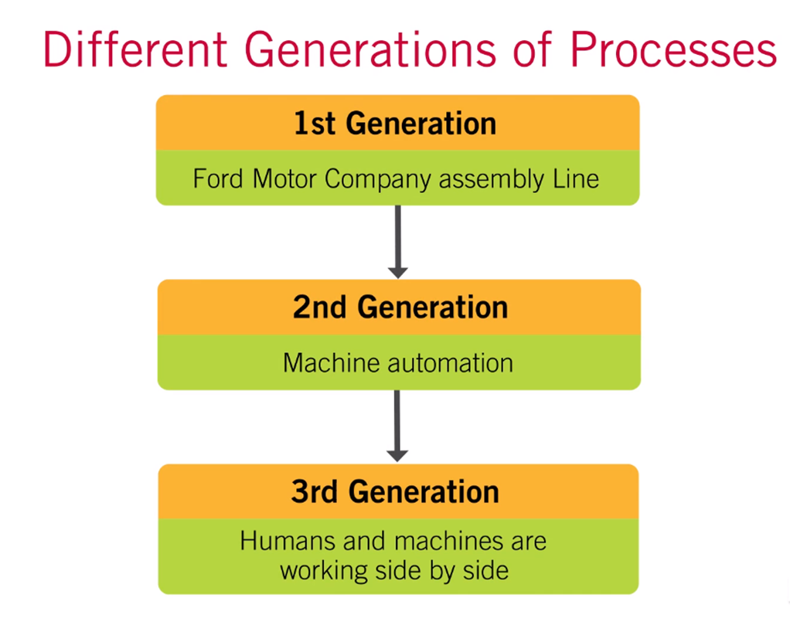
Disruptions in Industries..
Welcome Artificial Intelligence Expert
Ford Company with its Model T and it's assembly line was the prime example of this generation;
Very routine and very repetitive processes;
Machines and Software matured replacing humans;
Automation of very fixed/hard to change processes on the factory floor;
More flexible and Agile processes with added intelligence;
Digital transformation & Artificial Intelligence systems, born for a more agile type of organization.

Slide 15
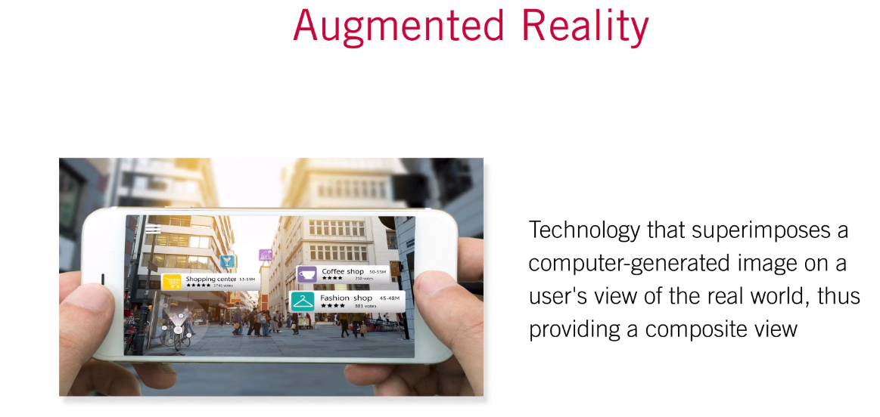
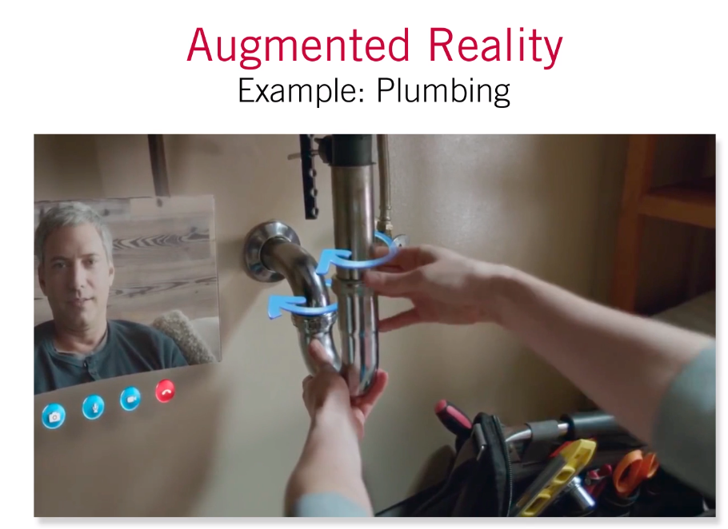
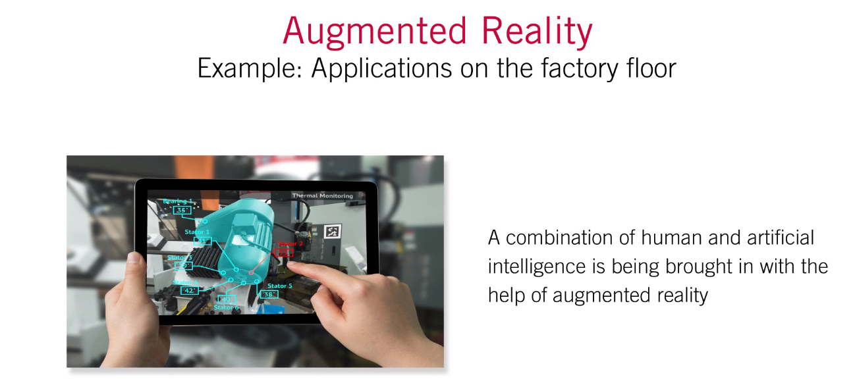
Augmented Reality with Examples
Welcome Artificial Intelligence Expert
Augmented Reality or Mixed Reality is the Overlaying of Intelligence onto our physical world added with Artificial Intelligence and Machine Learning Algorithms could provide some great insights or capabilities in many contexts.

Slide 16
Building Capabilities Data & Data Science Team

Slide 17
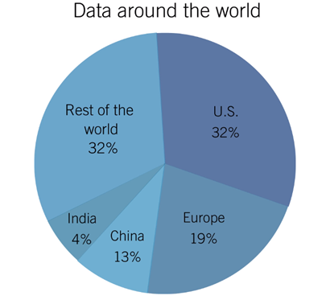
Unequal Distribution of data around the world
Welcome Artificial Intelligence Expert
Barrier to Compete – Data
Oncoming data generation of autonomous vehicles is estimated to be 4 TB per day
Voice platforms have over 60,000 hours of audio, which is equivalent to 6 years of audio and transcripts
New Products have:
New data strategies
The ability to be able to be the leader in that space
The ability to outperform the rest of the filled due to the information collected
The ability to make inroads in other industries and have a competitive advantage

Slide 18
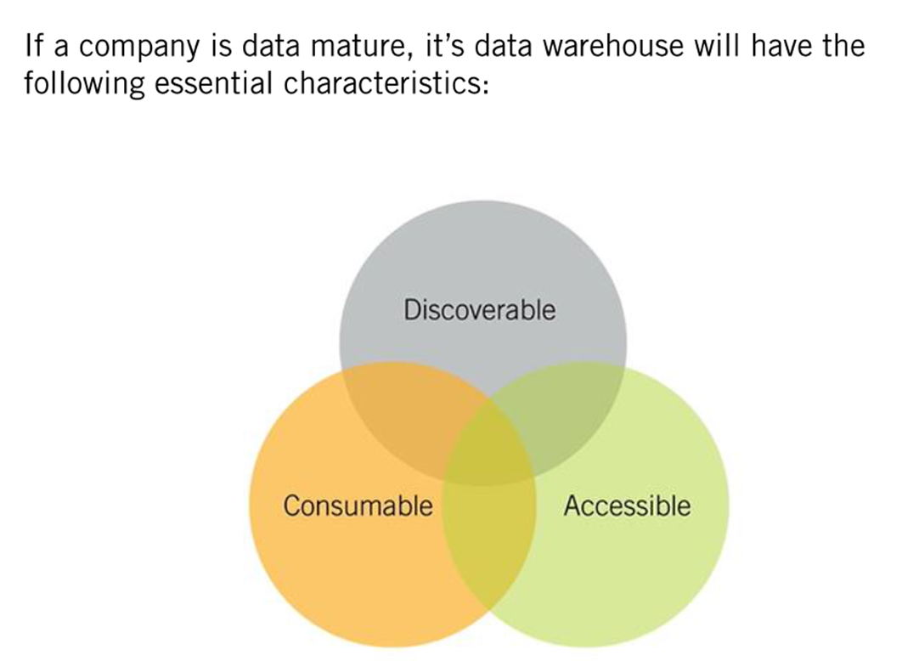
Matured Organization
Welcome Artificial Intelligence Expert
Creating a Data Science Team
To start small
Start to provide support to many of the products within the organization
Infuse resources to the products
Build the core capability

Slide 19
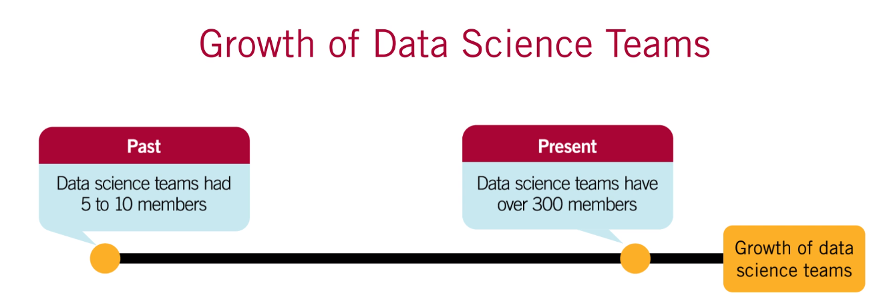
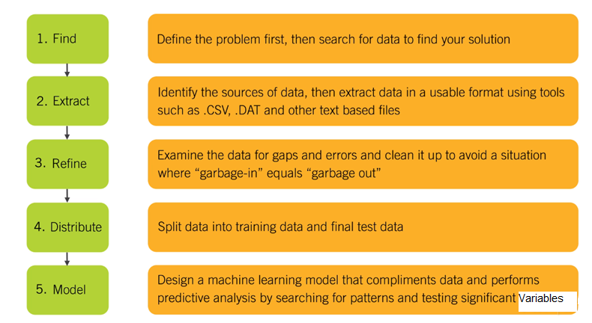
Data Science and Decision Making
Welcome Artificial Intelligence Expert

Slide 20
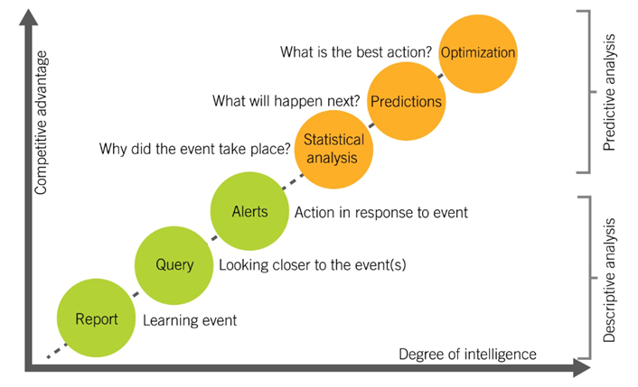
Maturity Levels for using ML & Artificial Intelligence
Welcome Artificial Intelligence Expert
Artificial Intelligence and Machine Learning is a transformative technology

Slide 21








Tools for Artificial Intelligence
Welcome Artificial Intelligence Expert
Python Libraries
Web Framework | Desktop Tools

Slide 22


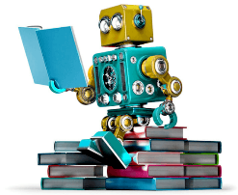
Artificial Intelligence Technologies
Welcome Artificial Intelligence Expert
Python
Statistics
Machine Learning
Deep Learning

Slide 23
Artificial Intelligence Applications

Slide 24
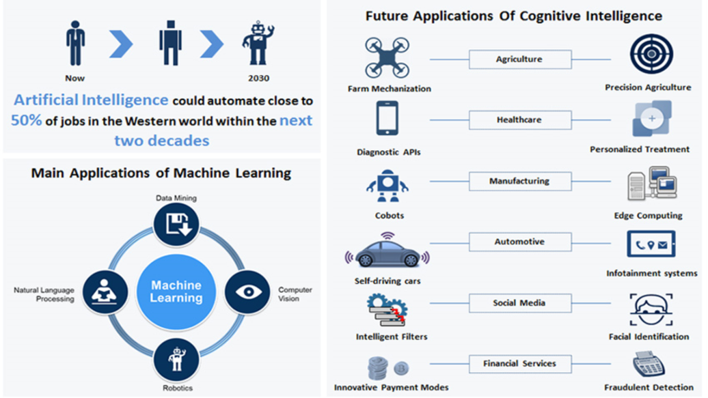
Artificial Intelligence Applications
Welcome Artificial Intelligence Expert

Slide 25
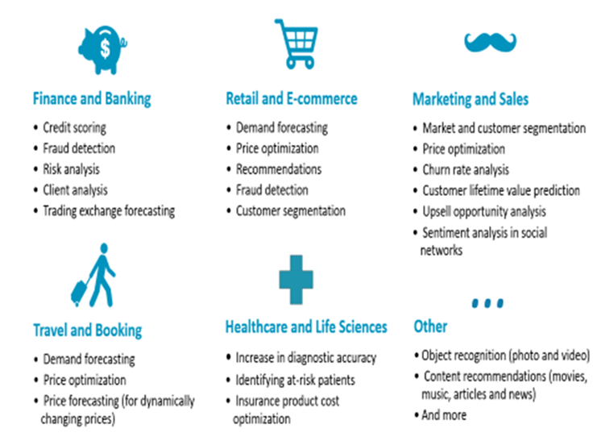
Artificial Intelligence Applications across the industry
Welcome Artificial Intelligence Expert

Slide 26
Futuristic Applications

Slide 27
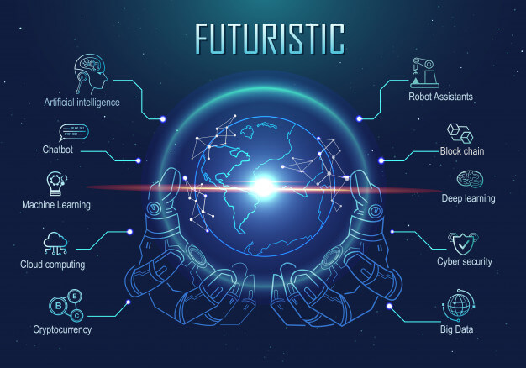
Futuristic Applications
Welcome Artificial Intelligence Expert

Slide 28
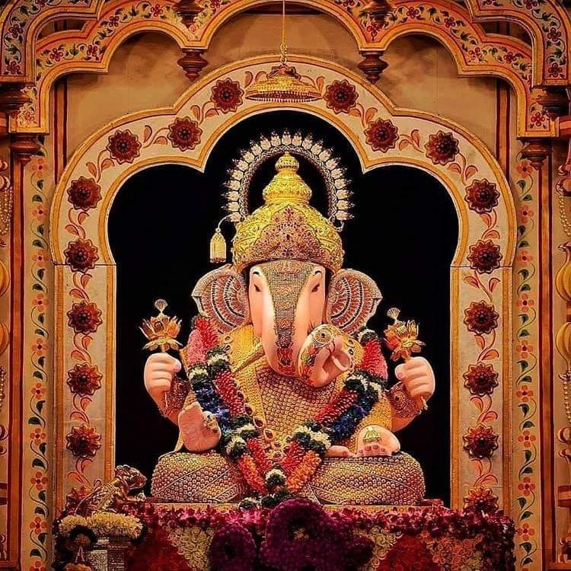

T h a n k Y o u !
I n t e l l e c t S r i r a m
Subscribed
LinkedIn : https://www.linkedin.com/in/sriram-balasubramanian-374566166/
GitHub : https://github.com/intellectsriram

